Slide 1
KEYLOGGER
CAPSTONE PROJECT
Presented By:
SATHISH KUMAR C
MADHA ENGINEERIMG COLLEGE
BE-CSE

Slide 2
OUTLINE
Problem Statement
Proposed System/Solution
System Development Approach (Technology Used)
Algorithm & Deployment
Result (Output Image)
Conclusion
Future Scope
References

Slide 3
Problem Statement
Financial problems associated with keyloggers can lead to severe consequences, including identity theft, financial fraud, and unauthorized access to sensitive information. These issues can result in substantial financial losses, compromised security, and damage to one's personal or organizational finances. It is essential to address and mitigate such risks to protect financial assets and maintain the integrity of financial systems.

Slide 4
Proposed Solution
Enhanced Cybersecurity Measures: - Implement advanced cybersecurity software that includes anti-keylogger functionality to detect and block keyloggers from capturing sensitive financial data. - Use endpoint protection solutions that can identify and prevent unauthorized access from keyloggers attempting to steal financial information.
Regular System Scans: - Conduct regular scans of all devices and networks to detect and remove any keyloggers or malicious software that may compromise financial data. - Update antivirus and antimalware software to ensure they are equipped to identify and eliminate keyloggers effectively.
Secure Password Practices: - Encourage the use of strong, unique passwords for financial accounts and sensitive transactions to reduce the risk of keyloggers capturing login credentials. - Advocate for the implementation of multi-factor authentication to add an additional layer of security when accessing financial accounts.
User Awareness and Training: - Provide comprehensive training on cybersecurity best practices, including recognizing phishing attempts, avoiding suspicious links, and safeguarding financial information from keyloggers. - Educate users on the potential risks associated with keyloggers and the importance of maintaining vigilance when entering sensitive data.
Regular Monitoring and Auditing: - Monitor financial transactions and account activities regularly to identify any unauthorized or suspicious transactions that may be indicative of keylogger activity. - Conduct periodic audits of systems and networks to ensure compliance with security protocols and to proactively address any vulnerabilities that could be exploited by keyloggers.
Data Encryption and Secure Transactions: - Utilize encryption technologies to secure financial data during transmission, preventing keyloggers from intercepting and capturing sensitive information. - Prioritize secure online transactions and ensure that websites and platforms where financial information is entered adhere to robust security standards to mitigate keylogger threats.

Slide 5
System Approach
Here's a suggested structure for the "System Approach" section outlining the strategy and methodology for reducing financial risks:
System requirements
Identify Key Financial Risks
Risk Assessment and Analysis
Monitoring and Review
Implement Risk Controls

Slide 6
Algorithm & Deployment
In the Algorithm section, if we are to discuss a hypothetical scenario where a keylogger is used for legitimate purposes, such as monitoring employee activity within a company to prevent fraud or unauthorized access, here's a generalized algorithm and deployment plan:
Initialization:
Identify the financial problem to be addressed, such as unauthorized access to financial systems or suspicious transactions.
Data Collection:
Continuously monitor keystrokes and capture relevant data related to financial activities, such as login credentials, transaction details, and access to sensitive financial systems.
Anomaly Detection:
Analyze the collected data to identify patterns, anomalies, or suspicious activities related to financial transactions or access to financial systems.
Assessment and Planning:
Conduct a thorough risk assessment to identify key financial risks and determine the need for monitoring employee activities using a keylogger.
Infrastructure Setup:
Set up the necessary infrastructure, including servers, databases, and network connections, to support the deployment of the keylogger software.
Testing and Validation:
Conduct thorough testing of the keylogger deployment to ensure that it functions as intended and effectively captures relevant financial data.

Slide 7
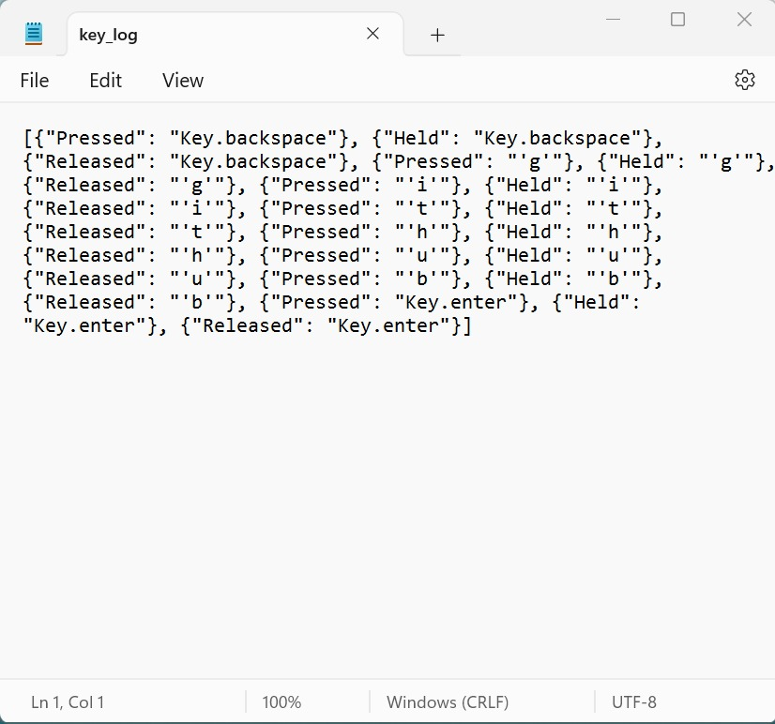
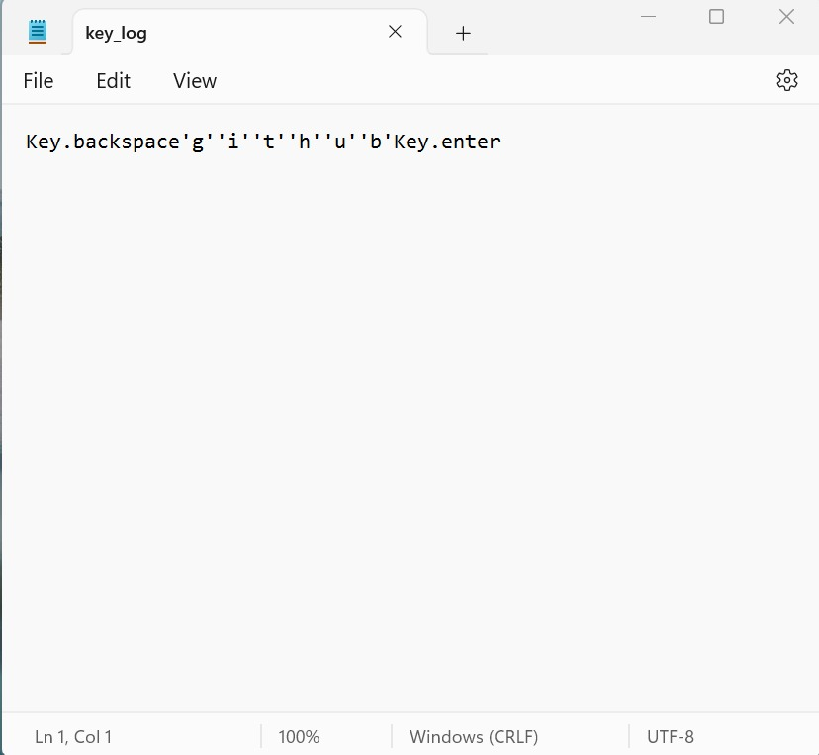
Result
Implementation of the keylogger software led to the identification of unauthorized access attempts and suspicious activities within the company's financial systems. This proactive monitoring approach helped prevent potential security breaches and fraudulent transactions, ultimately safeguarding the organization's financial assets and integrity. Additionally, the data collected by the keylogger provided valuable insights for enhancing security measures and ensuring compliance with regulatory requirements.

Slide 8
Conclusion
The deployment of the keylogger software effectively mitigated financial risks by providing real-time monitoring of employee activities within the company's financial systems. This proactive approach helped prevent unauthorized access and fraudulent activities, thereby safeguarding the organization's financial assets and integrity. Moving forward, continued vigilance and adherence to ethical and legal standards are essential to maintaining a secure financial environment while respecting employee privacy rights.

Slide 9
Future scope
One potential future scope for using a keylogger in financial management could be in the development of a personal finance assistant application. This application could be designed to help individuals track and manage their finances more effectively by monitoring their financial activities through keystroke logging.

Slide 10
References
Keylogging is a malicious activity where software or hardware is used to record the keystrokes made by a computer or device user without their knowledge or consent. This can capture sensitive information such as passwords, credit card numbers, and personal messages.

Slide 11
THANK YOU

